Slide 1

Objectives
In this session, you will learn about:
  Special characters in HTML
  Special Effect Tags

Slide 2
Special Characters in HTML
Special characters:
  Are characters that have a special meaning, when used in HTML code.
  Are interpreted with their special meanings when encountered in code.
  Need to be referenced in a different way to display them as literals on the screen.
HTML provides the following two ways of referencing special characters:
  Entity numbers
  Entity names

Slide 3
Special Characters in HTML (Contd.)
When using entity numbers, specify the American Standard Code for Information Interchange (ASCII) value of the special character that is to be included in the HTML document.
An ASCII value represents the English characters as numbers, with each letter assigned to a number from 0 to 127.
To display a special character in an HTML document, precede the ASCII value of the character by the ampersand (&) and the hash (#) symbol.
For example, to display the heading of a Web page as Using <HEAD> Tag, the code will be:
  <BODY>
  <H1> Using &#60 HEAD &#62 Tag </H1>
  </BODY>

Slide 4
Special Characters in HTML (Contd.)
The following table lists some characters and their corresponding ASCII values.
Character | ASCII Value
: | 58
; | 59
< | 60
= | 61
> | 62
? | 63
@ | 64
! | 33
“ | 34
# | 35
$ | 36
% | 37
& | 38
Notes:
Show all the controls using visual studio and discuss the use of few controls.

Slide 5
Special Characters in HTML (Contd.)
When using entity names, specify the HTML entity name for the character.
HTML entities are special characters used for defining an HTML tag.
For example, to display the heading of a Web page as Using <HEAD> Tag, the code will be:
  <BODY>
  <H1> Using &lt; HEAD &gt; Tag </H1>
  </BODY>
Notes:
Show all the controls using visual studio and discuss the use of few controls.

Slide 6
Special Characters in HTML (Contd.)
The following table lists some of the special characters used in HTML, along with their entity references.
Characters/ Symbols | Entity Reference | Meaning
¿ | &iquest; | Inverted question mark
& | &amp; | Ampersand
© | &copy; | Copyright
" | &quot; | Quotation mark
È | &Egrave; | Capital E with grave accent
° | &deg; | Degree
½ | &frac12; | Fraction one-half
Notes:
Show all the controls using visual studio and discuss the use of few controls.

Slide 7
Special Effect Tags
Special Effect Tags are the tags used in HTML to enhance the visual appeal of a Web page.
These tags can be used to change the size and appearance of the text in a Web page.
These tags can also be used to add special effects, such as scrolling of the text in an HTML document.
Some of the special effect tags in HTML are:
  <CITE> tag
  <STRONG> tag
  <MARQUEE> tag
  <BIG> tag
  <SMALL> tag
Notes:
Show all the controls using visual studio and discuss the use of few controls.

Slide 8

Special Effect Tags (Contd.)
<CITE> Tag:
  Is used to cite a particular book, journal, or Web site as reference.
  The following example illustrates the use of the <CITE> tag:
    <BODY>
    To get more information about the HTML, you can refer:
    <CITE>HTML: The Definitive Guide </CITE> by O’Reilly publication
    </BODY>
    The preceding code will generate a result as shown in the following figure.
Notes:
Show all the controls using visual studio and discuss the use of few controls.

Slide 9

Special Effect Tags (Contd.)
<STRONG> Tag:
  Is used to provide strong emphasis or boldface to the text in an HTML document.
  The following example illustrates the use of the <STRONG> tag:
    <Body>
    <P> One Audio CD is <STRONG>FREE</STRONG> with every purchase you make in this store</P>
    </Body>
    The preceding code will generate a result as shown in the
    following figure.
Notes:
Show all the controls using visual studio and discuss the use of few controls.

Slide 10
Special Effect Tags (Contd.)
<MARQUEE> Tag:
  Is used to make text slide or scroll in a particular region of an HTML document.
  Has attributes to set the behavior, direction, width, and color of the affected text.
  The following example illustrates the use of the <MARQUEE> tag:
    <BODY>
    <MARQUEE BEHAVIOR= slide DIRECTION="left" WIDTH =250 BGCOLOR=cyan> This is a &lt;MARQUEE&gt; text</MARQUEE>
    </BODY>
Notes:
Show all the controls using visual studio and discuss the use of few controls.

Slide 11

Special Effect Tags (Contd.)
<BIG> Tag:
  Is used to increase the font size of the text to the next larger size.
  The following example illustrates the use of the <BIG> tag:
    <Body>
    <P> You will get <BIG>20% discount</BIG> on every purchase you make in this store.</P>
    </Body>
    The preceding code will generate a result as shown in the following figure.
Notes:
Show all the controls using visual studio and discuss the use of few controls.

Slide 12

Special Effect Tags (Contd.)
<SMALL> Tag:
  Is used to decrease the font size of the text to the next smaller size.
  The following example illustrates the use of the <SMALL> tag:
    <Body>
    <P>You will get 20% discount on every purchase you make in this store.</P>
    <P><SMALL>Conditions Apply.</SMALL></P>
    </Body>
    The preceding code will generate a result as shown in the following figure.
Notes:
Show all the controls using visual studio and discuss the use of few controls.

Slide 13
Best Practices
Ensure that the tags in your HTML document are nested properly. For example, consider an HTML document containing tags in the following sequence:
<TAG1><TAG2><TAG3> Text </TAG3></TAG1></TAG2>
Using such a sequence is not a good practice. Browsers such as Internet Explorer might ignore this type of sequence and may display the content correctly. However, Netscape Navigator may not display the content properly.
When you create a starting tag, create the corresponding closing tag at the same time. This will help you maintain the correct nesting of tags in your HTML document. For example, when you create the <HTML> tag, create the </HTML> tag also. All tags that need to nested within these tags, can then be embedded between the <HTML> and </HTML> tags.
Notes:
Show the demo by performing each step to set Web server control properties
Explain by example how to manipulate Web server control (refer SG)

Slide 14
Best Practices (Contd.)
Structure the code properly, so that it can be easily understood. The following figure shows two samples of HTML code.
<HTML><HEAD><TITLE>My First Document </TITLE> </HEAD> <BODY><H1>Best Coding Practices</H1></BODY></HTML> |  | <HTML> <HEAD> <TITLE> My First Document </TITLE> </HEAD> <BODY> <H1> Best Coding Practices </H1> </BODY> </HTML>
Although, both the preceding code samples are same and give the same output, the HTML code in the second sample is easier to read and understand.
Notes:
Show the demo by performing each step to set Web server control properties
Explain by example how to manipulate Web server control (refer SG)

Slide 15
Best Practices (Contd.)
The various elements of a form should be arranged inside a table to ensure proper alignment of the various form elements with each other. Consider the following code snippet that creates a form without using a table:
  <HTML>
  <BODY>
  <FORM ACTION="mailto:xyz@simplesolutions.com?Subject=Feedback" Method=”post”>
  User Name: <INPUT TYPE="text" NAME="txtname"><br> Password: <INPUT TYPE="password" NAME="txtpass"><br> Comments: <TEXTAREA rows=10 cols=10></TEXTAREA> <INPUT TYPE = "Submit" VALUE = "Submit Your Feedback“> </FORM> </BODY> </HTML>
Notes:
Show the demo by performing each step to set Web server control properties
Explain by example how to manipulate Web server control (refer SG)

Slide 16
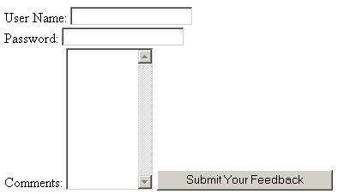
Best Practices (Contd.)
The following figure displays the output of the preceding code.
Now, consider the following code snippet that uses a table to organize the elements on a form.
  <HTML>
  <BODY>
  <FORM ACTION="mailto:xyz@simplesolutions.com" Method=”post”>
Notes:
Show the demo by performing each step to set Web server control properties
Explain by example how to manipulate Web server control (refer SG)

Slide 17
Best Practices (Contd.)
  <TABLE>
  <TR>
  <TD>User Name:</TD>
  <TD><INPUT TYPE="text" NAME="txtname"></TD>
  </TR>
  <TR>
  <TD>Password:</TD>
  <TD><INPUT TYPE="password”
  NAME="txtpass"></TD>
  </TR>
  <TR>
    <TD>Comments:</TD>
  <TD><TEXTAREA rows=10
  cols=10></TEXTAREA></TD>
  </TR>
Notes:
Web Server controls are automatically configured with the runat="server" attribute, so there is no need to convert them as there is for HTML server controls.
Edit the ID attribute that Visual Studio automatically assigns.

Slide 18
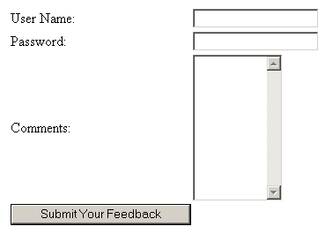
Best Practices (Contd.)
  <TR>
    <TD><INPUT TYPE = "Submit" VALUE = "Submit Your Feedback"></TD>
  </TR>
  </TABLE>
  </FORM> </BODY></HTML>
The following figure displays the output of the preceding code.
Notes:
Show the demo by performing each step to set Web server control properties
Explain by example how to manipulate Web server control (refer SG)

Slide 19
Tips and Tricks
Publishing HTML Code on a Web Page:
  You may need to display HTML source code on your Web pages to explain the use of the code, without the code being executed by the browser. For example, in an HTML tutorial Web site, you may need to show some HTML code. For such cases, you can use the <XMP> tag that allows you to include the examples of the source code on your Web pages. When the Web browser encounters the <XMP> tag, it does not execute the content enclosed within these tags. The following example illustrates the use of the <XMP> tag:
    <HTML>
    <BODY>
    Consider the following code snippet:
    <XMP>
    <HTML>
Notes:
Show the demo by performing each step to set Web server control properties
Explain by example how to manipulate Web server control (refer SG)

Slide 20
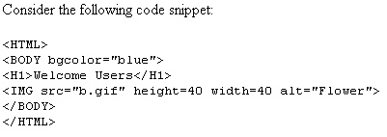
Tips and Tricks (Contd.)
  <BODY bgcolor="blue">
  <H1>Welcome Users</H1>
  <IMG src="b.gif" height=40 width=40 alt="Flower">
  </BODY>
  </HTML>
  </XMP>
  </BODY>
  </HTML>
  The following figure displays the output of the preceding code.
Notes:
Show the demo by performing each step to set Web server control properties
Explain by example how to manipulate Web server control (refer SG)

Slide 21
Tips and Tricks (Contd.)
Enhancing Form Display:
  Internet Explorer 4.0 and later support several features to enhance the organization and layout of a form. Some of these features are:
    The FIELDSET tag: Used to group related controls by placing them together inside a bordered field. The syntax of the FIELDSET tag is:
    <FIELDSET> controls to be grouped </FIELDSET>
    The LEGEND tag: Used to provide a title to the field. The syntax of the LEGEND tag is:
    <LEGEND> Title for the fields </LEGEND>
    The ACCESSKEY attribute: Used to specify a keyboard combination to access the controls in the form. The syntax of the ACCESSKEY attribute is:
    <INPUT ACCESSKEY = “key combination”>
Notes:
Show all the controls using visual studio and discuss the use of few controls.

Slide 22
Tips and Tricks (Contd.)
  The following example illustrates the use of the FIELDSET and LEGEND elements as well as the ACCESSKEY attribute:
    <HTML>
    <BODY>
    <FORM>
    <!--Declaring the FIELDSET element to group the
    elements-->
    <FIELDSET STYLE="height: 100; width: 200“>
    <!--Declaring the LEGEND element to provide title
    to the fields-->
    <LEGEND>Login Information</LEGEND>
    <TABLE>
    <TR>
    <TD> <!--Underlining the letter U of Username-->
    <LABEL><SPAN STYLE = "text-decoration:
    underline;">U</SPAN>sername
    </LABEL> </TD><TD>
Notes:
FAQ Explain the HTTP is state less protocol it does not store any reference of previous request even with the same user. Server has to maintain such information pragmatically.
Explain how round trip processing maintain this state.

Slide 23
Tips and Tricks (Contd.)
    <!--Specifying the access key for the username-->
    <INPUT TYPE = "text" NAME = "txtUsername" ACCESSKEY = "U"> </TD> </TR>
    <TR> <TD>
    <!--Underlining the letter P-->
    <LABEL><SPAN STYLE = "text-decoration: underline;">P</SPAN>assword
    </LABEL> </TD>
    <TD>
    <!--Specifying the access key for the Password field-->
    <INPUT TYPE = "text" NAME = "txtPassword" ACCESSKEY = "P">
    </TD> </TR> </TABLE> </FIELDSET>
    </FORM>
    </BODY>
    </HTML>
Notes:
FAQ Explain the HTTP is state less protocol it does not store any reference of previous request even with the same user. Server has to maintain such information pragmatically.
Explain how round trip processing maintain this state.

Slide 24
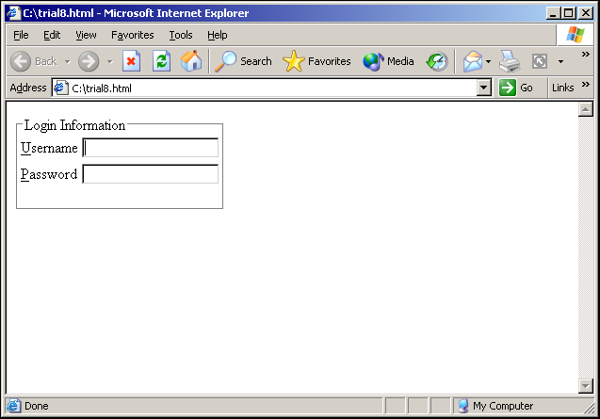
Tips and Tricks (Contd.)
  The following figure displays the output of the preceding code.
Notes:
FAQ Explain the HTTP is state less protocol it does not store any reference of previous request even with the same user. Server has to maintain such information pragmatically.
Explain how round trip processing maintain this state.

Slide 25
FAQs
Can I create links without underline?
  Yes, you can create links without underline. You can use the STYLE attribute of the anchor element as illustrated in the following code to create links without underline:
  <A HREF ="C:\IMAGE\CIRCLE.BMP" STYLE ="TEXT-DECORATION: =NONE">
How can I make the background image of my Web page stationary?
  Stationary background images remain in one place even when scrolling through the Web page. Only the text will move.
  To create this effect, you need to place the following code within the <BODY> tag:
  <body background ="yourimage.gif" bgproperties="Fixed">
Notes:
Explain with example of ListBox and DropDownList control given SG in Auto Postback
Discuss when we set EnableViewState Property to true
Explain the difference between postback on self page and postback on crosspage

Slide 26
FAQs (Contd.)
  The preceding code, displays the image, yourimage.gif, in the background of the Web page. The bgproperties attribute with the value, Fixed, will make the background image stationary when scrolling through the Web page.
How can I place text over an image, using HTML?
  You can place text over an image by using the <TD> tag in a table. To place text over an image:
    Use the BACKGROUND attribute of the <TD> tag to place the image as background of table data.
    Place the text between the <TD> and </TD> tags.
  Consider the following code:
    <HTML>
    <HEAD>
    <TABLE border="0" cellpadding="0" cellspacing="0">
    <TR> <TD width="400" height="500" background="image.jpg" valign="center">
Notes:
Explain with example of ListBox and DropDownList control given SG in Auto Postback
Discuss when we set EnableViewState Property to true
Explain the difference between postback on self page and postback on crosspage

Slide 27
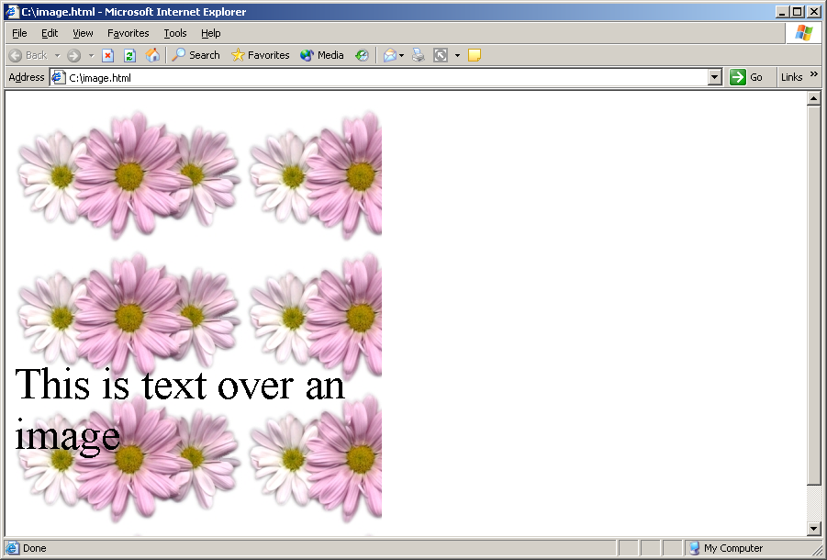
FAQs (Contd.)
    <FONT SIZE="+5" color=""><BR><BR><BR>This is text over an image </FONT></TD>
    </TR>
    </TABLE>
    </HEAD>
    </HTML>
  The preceding code creates a table with image.jpg as the background of one of its cells and places text inside the cell.
  The following figure displays the output of the preceding code.
Notes:
Explain with example of ListBox and DropDownList control given SG in Auto Postback
Discuss when we set EnableViewState Property to true
Explain the difference between postback on self page and postback on crosspage

Slide 28
Challenge
The _________ attribute of the image tag is used to specify that the image will be used as an image map.
Answer:
  usemap
Notes:
Show the demo by performing each step to set Web server control properties
Explain by example how to manipulate Web server control (refer SG)

Slide 29
Challenge (Contd.)
The _____________ type value of the <INPUT> tag is used to create invisible fields.
Answer:
  hidden
Notes:
Show the demo by performing each step to set Web server control properties
Explain by example how to manipulate Web server control (refer SG)

Slide 30
Challenge (Contd.)
The ______________ attribute allows control over the space inserted between the cell data and the cell wall in a table.
Answer:
  cellpadding
Notes:
Show the demo by performing each step to set Web server control properties
Explain by example how to manipulate Web server control (refer SG)

Slide 31
Challenge (Contd.)
You have created a hyperlink on a Web page. You want to open the Web page corresponding to the hyperlink on a new Web page. How will you address the given requirement?
Answer:
  You can use the TARGET attribute of the <A> tag to open the Web page corresponding to a hyperlink in a new blank window. You need to provide the reserved name _blank as the target name. The following example illustrates how to use this tag:
  <A HREF=”url.html” TARGET=”_blank”>
Notes:
Show the demo by performing each step to set Web server control properties
Explain by example how to manipulate Web server control (refer SG)

Slide 32
Challenge (Contd.)
You have created a hyperlink on a Web page. You want the hyperlink to link to a particular area on another Web page. How will you address this requirement?
Answer:
  By default, a hyperlink takes the user to the beginning of the linked Web page. To enable the hyperlink to jump to a particular text block in a new Web page, you need to identify and name the text location with the help of the NAME attribute of an <A> tag. Then, you need to specify the name of the location along with the Web page name, while creating the hyperlink. The syntax for naming a location in the linked Web page is <A NAME =”location_name”>.
  The preceding code will be placed at the text location where you would like the user to view a particular text block in a Web page when the hyperlink is clicked.
Notes:
Show the demo by performing each step to set Web server control properties
Explain by example how to manipulate Web server control (refer SG)

Slide 33
Challenge (Contd.)
  The syntax for creating a link that refers to a named location in a Web page is:
  <A href=”filename.html#location_name”> ……….</A>
  The preceding code will be placed where you create the hyperlink in a Web page.
Notes:
Show the demo by performing each step to set Web server control properties
Explain by example how to manipulate Web server control (refer SG)

